Slide 1


Slide 2
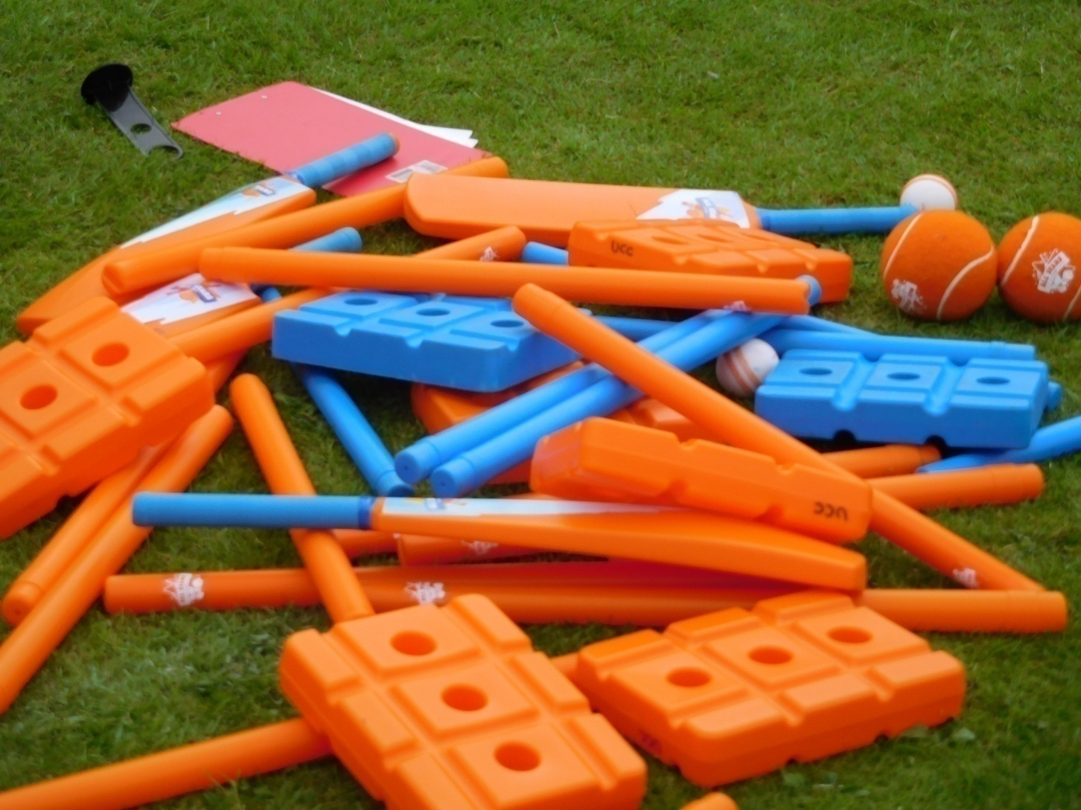
What has worked for others;
Taster sessions with offers
W&G Festivals
Primary & Secondary Schools
AllStars and Dynamos
Activator training
Coach education
Perseverance!

Slide 3
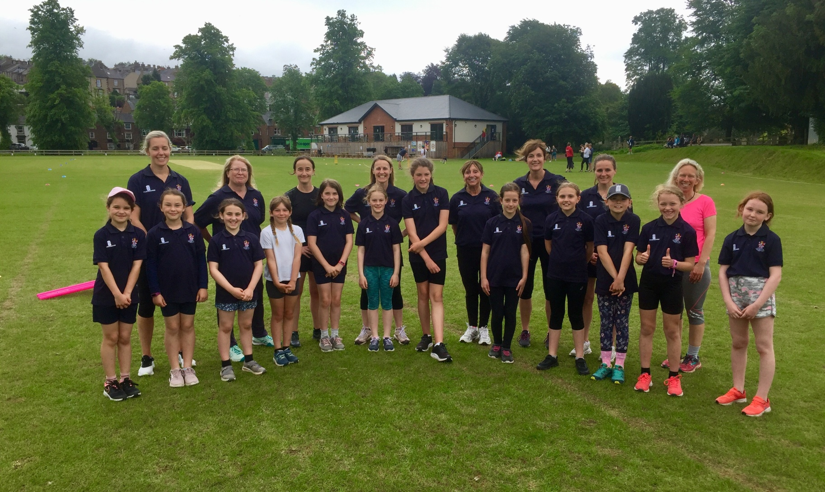
2021
ULVERSTON ROCKETS & COMETS

Slide 4
What does you club season look like?
W&G section
  Softball League North alongside West and South
  Where does your club fit?
  10 games home & away plus local friendlies
  Other festivals
  Hardball league
  County Age Group representation
  MCC Hubs – Penrith & Ulverston

Slide 5

What’s next?
* W&G development plan
* Safe hands (Club Welfare)
* Willing volunteers!
* Access resources (we got game)
* Case studies from other clubs
* Action plan to include EDI
* ICEC report

Slide 6
FIBRUS 100
Eden Eagles – Appleby, Penrith, Edenhall, Threlkeld, Stainton
Central Sixers – Netherfield, Kendal, Arnside, Carnforth, Milnthorpe, Sedgwick
Southern Power – Ulverston, Dalton, Lindal, Barrow, Haverigg, Millom, Coniston
Western Boom – Workington, Whitehaven, Egremont, Cockermouth,
Sedberghians – Sedbergh School
Northern Blast – Carlisle, Keswick, Wigton, Wetherall, Lanercost

Slide 7
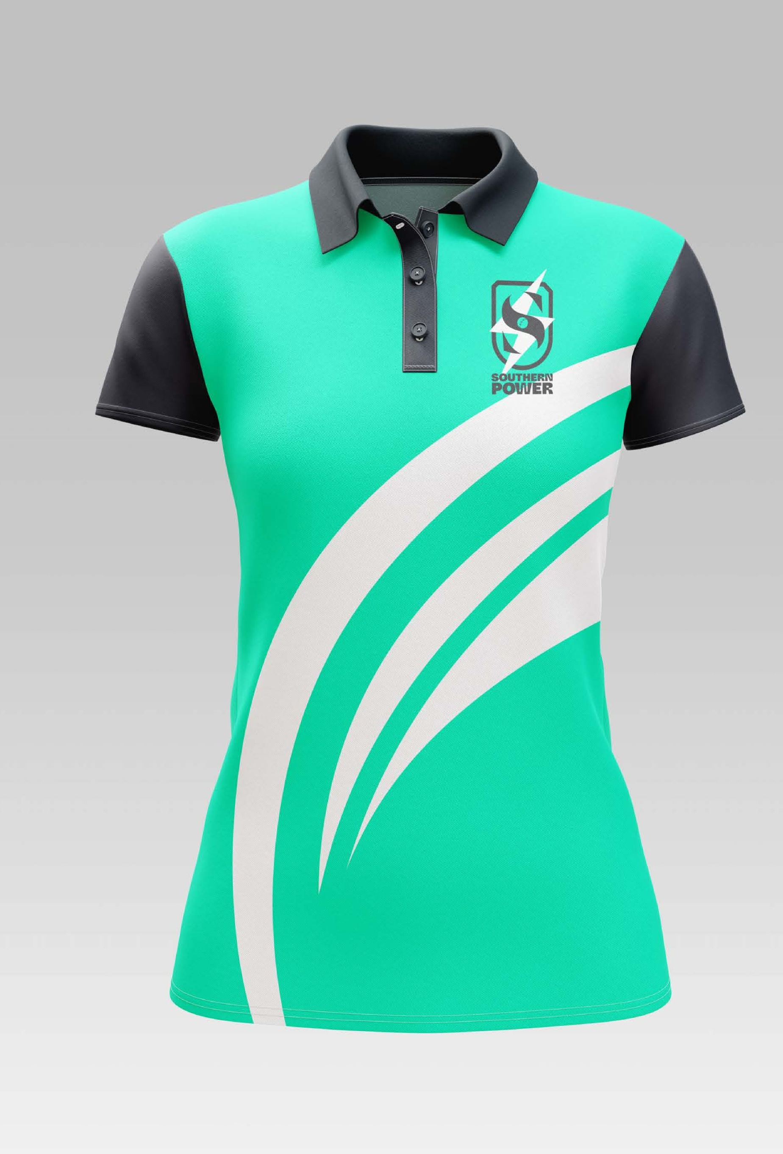


SOUTHERN
POWER

Slide 8
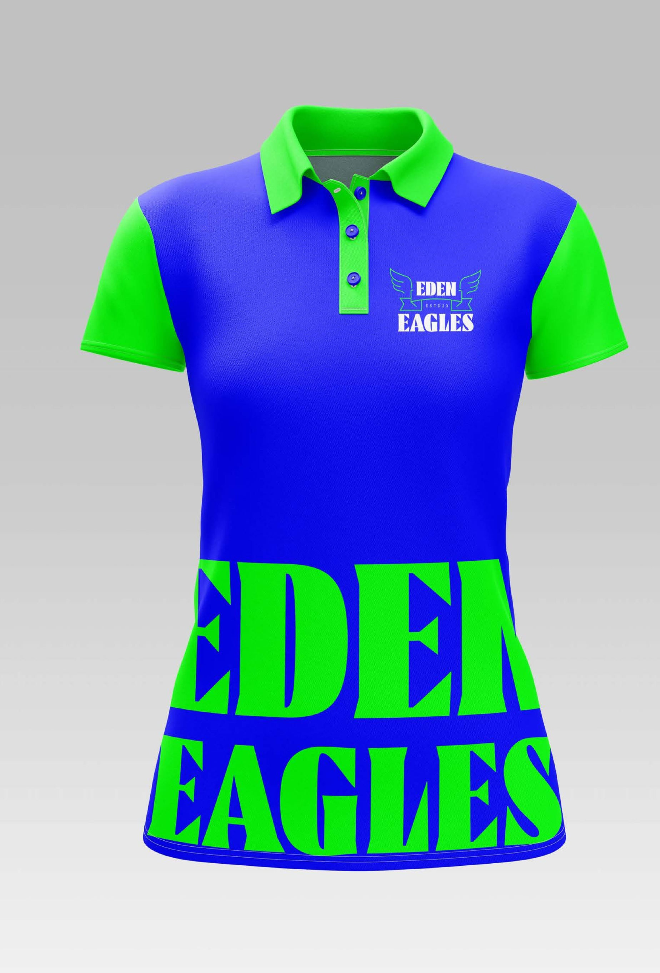
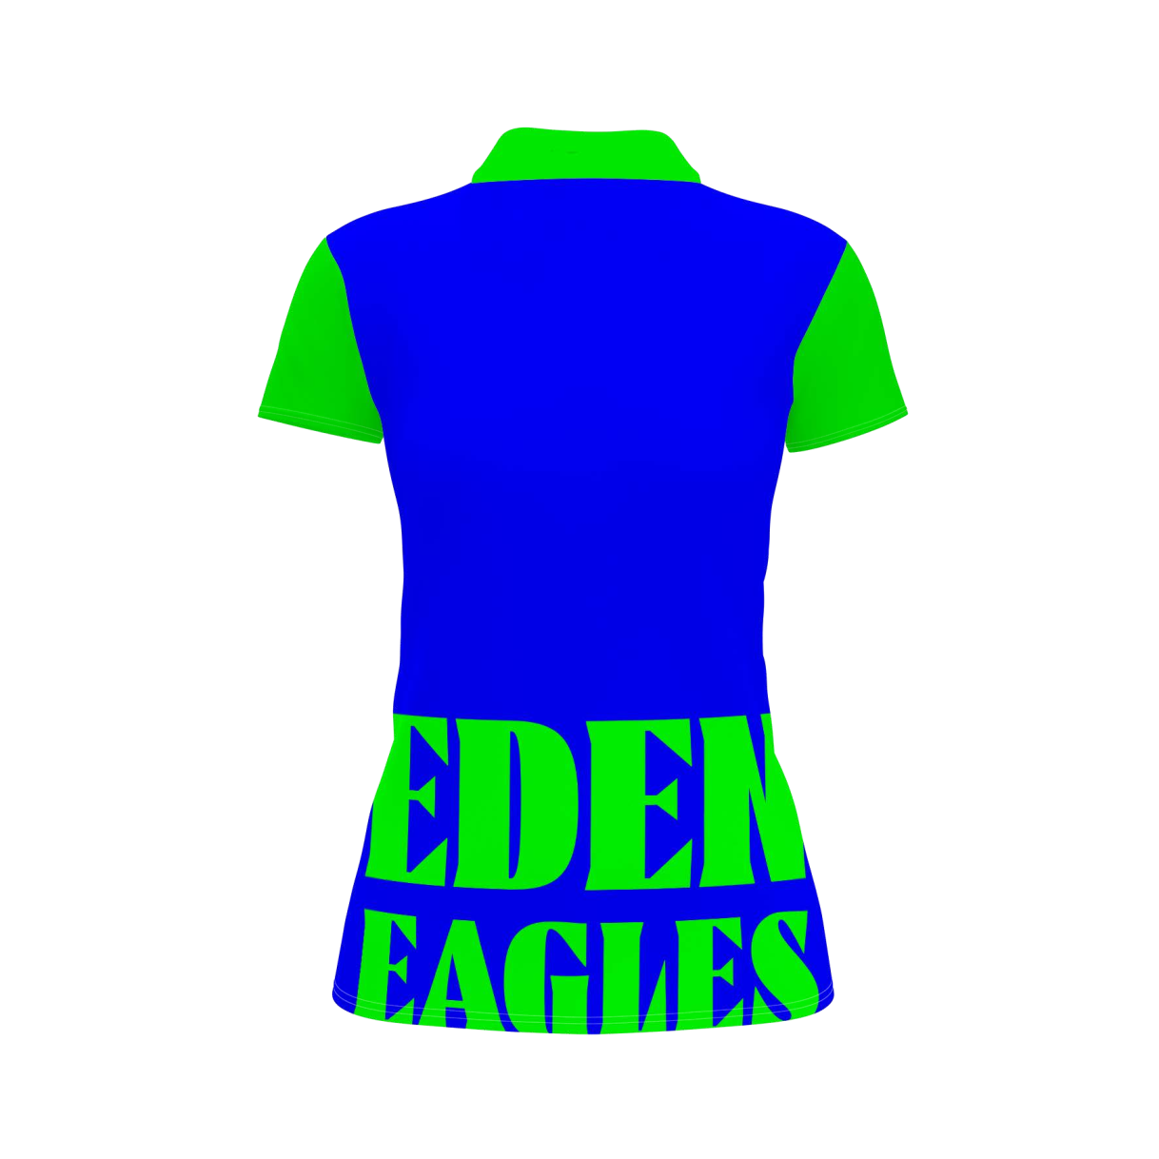

E S T D 2 3

Slide 9
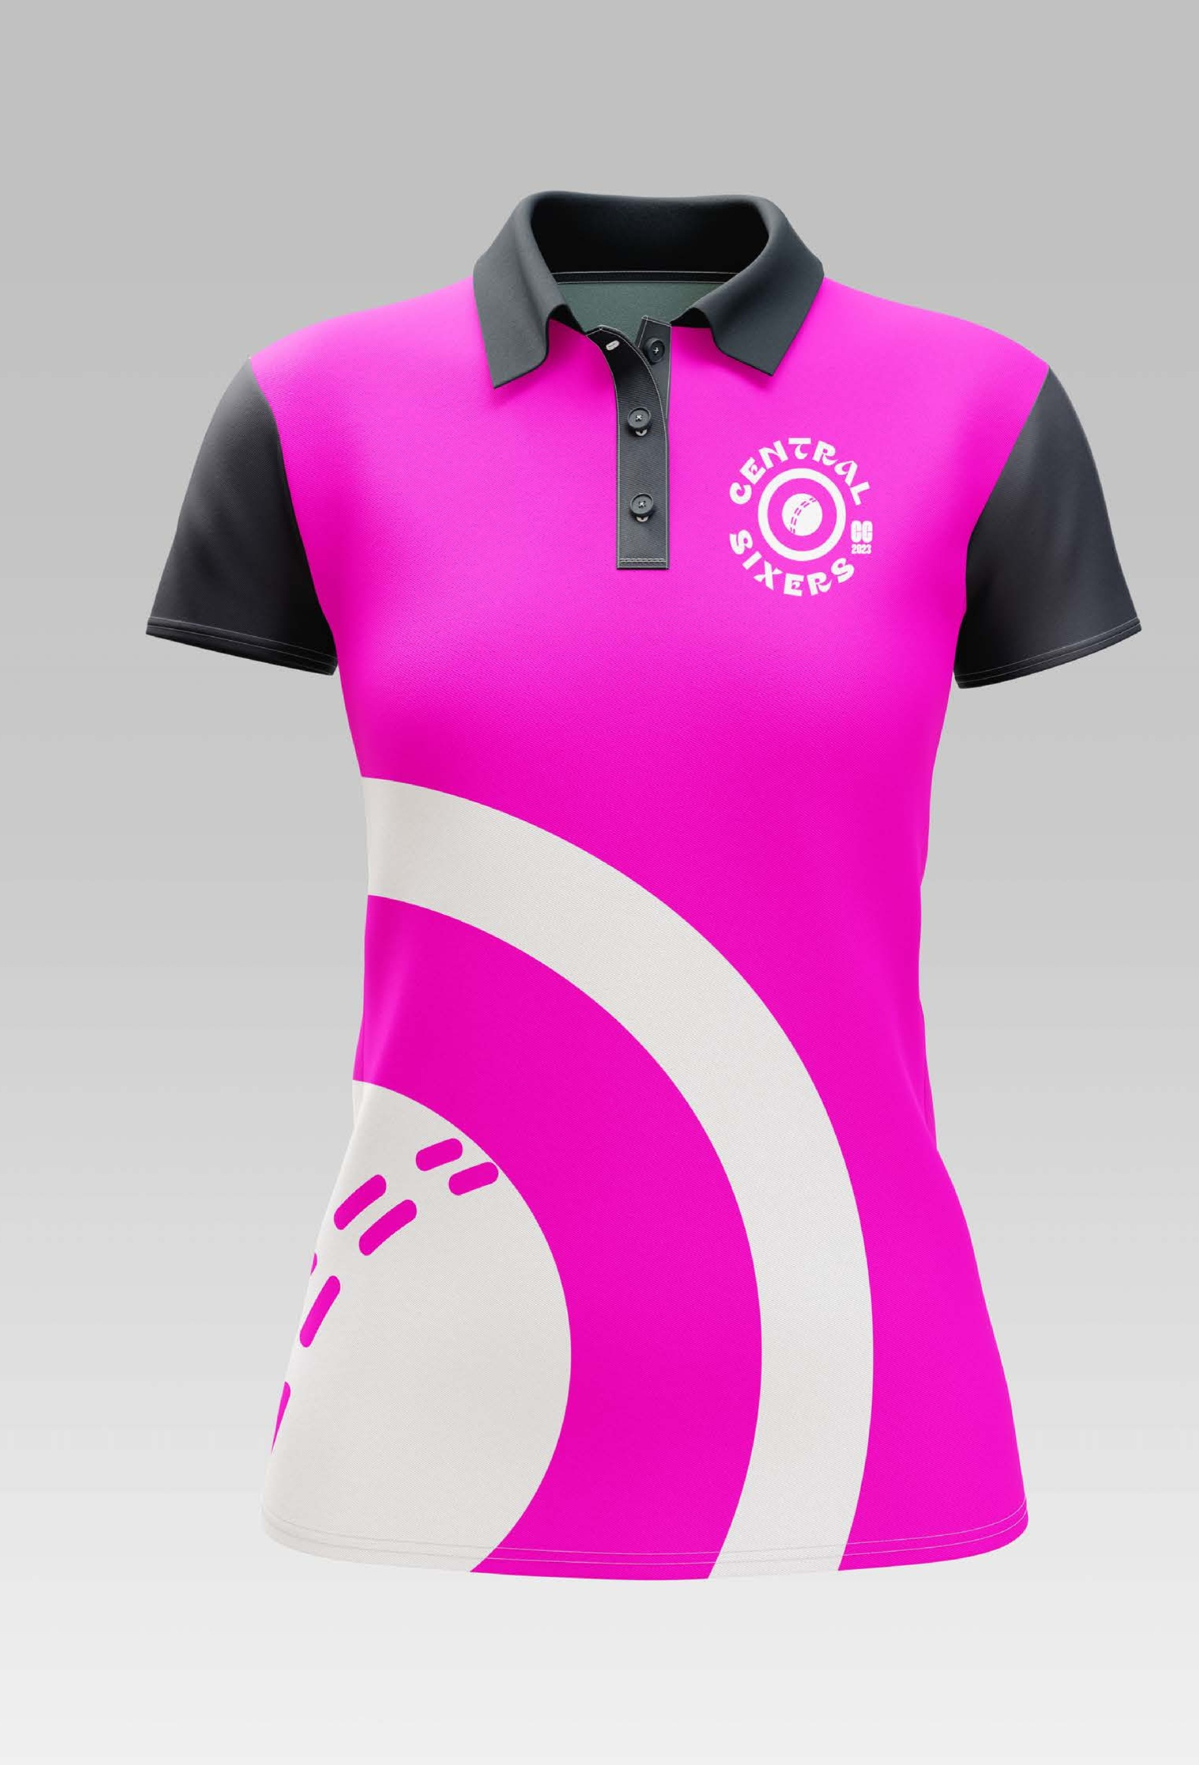

2023
T
R
N
E
A
C
L
CC
S
I
X
S
E
R

Slide 10
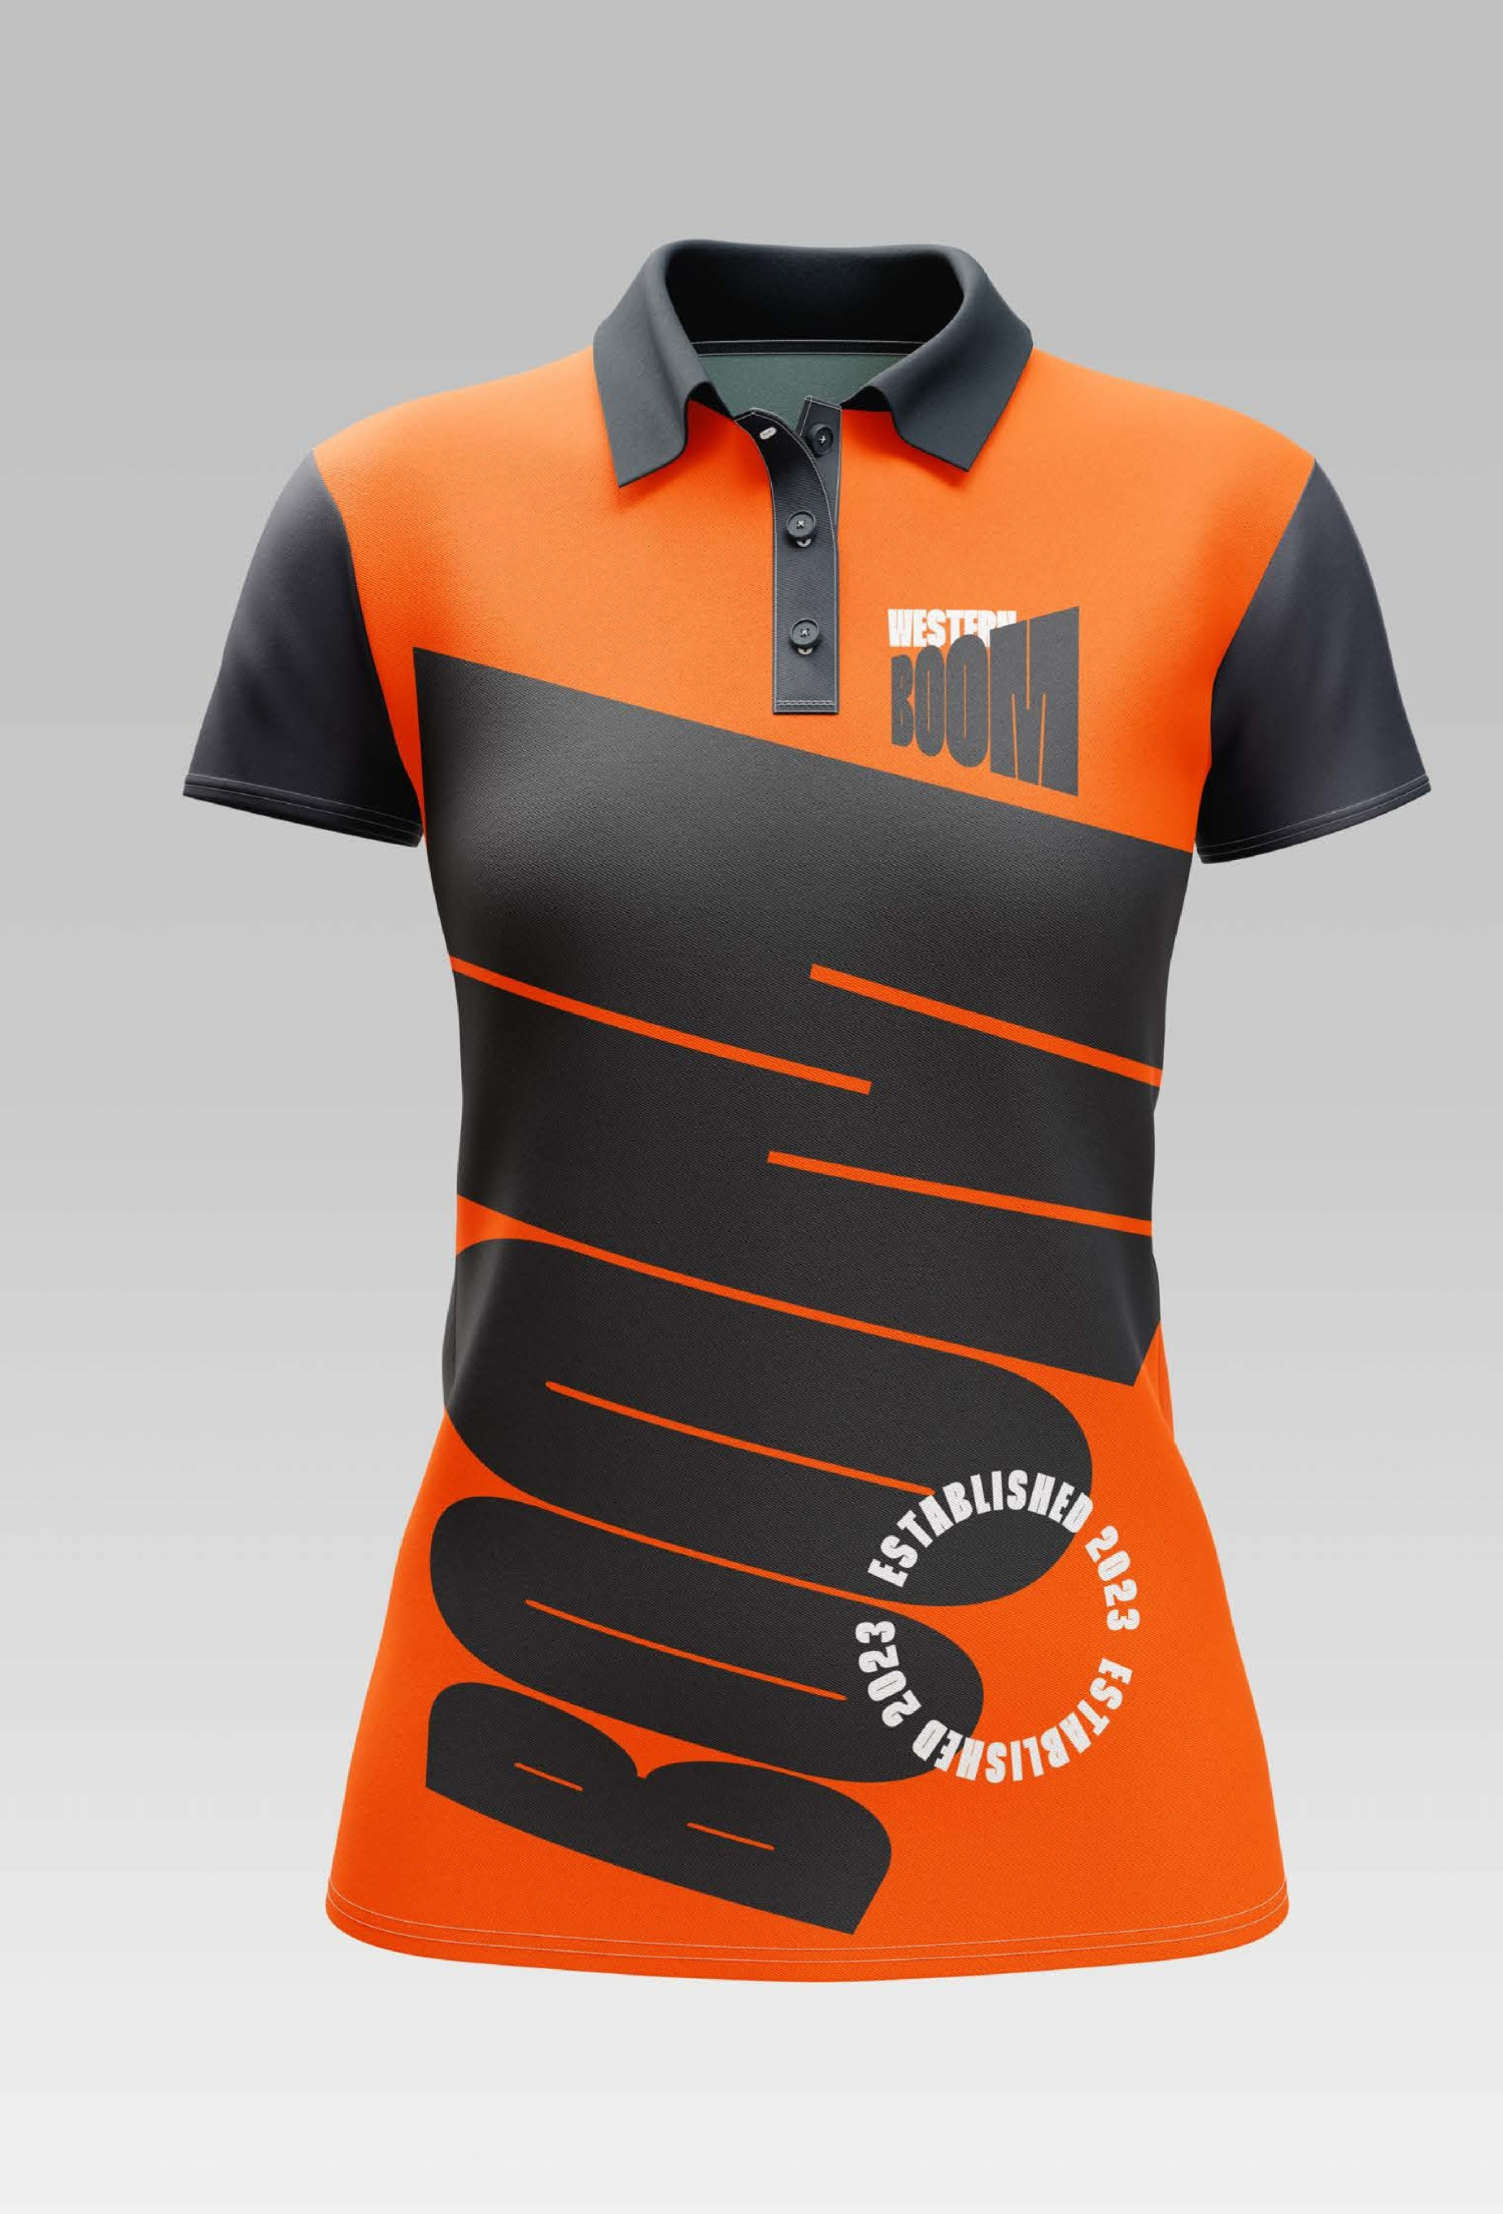
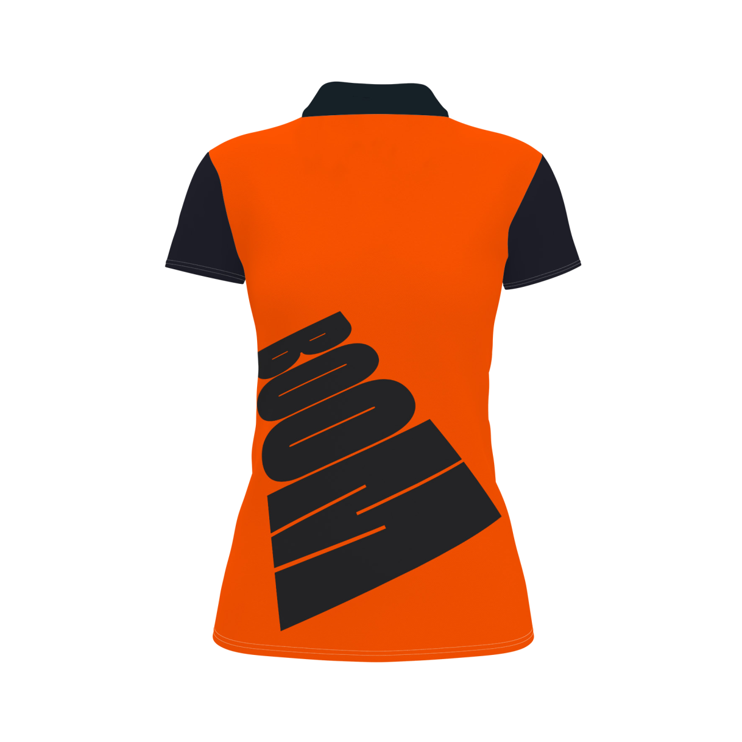
I
L
S
B
H
A
E
T
D
S
2
E
0
2
3
3
2
E
0
S
2
T
D
A
E
B
H
L
I
S

Slide 11
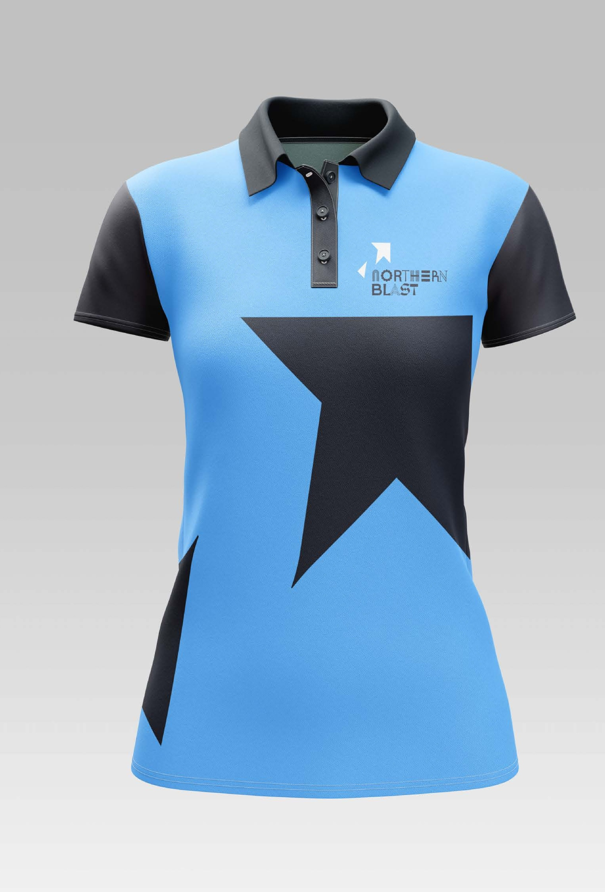

NORTHERN BLAST

Slide 12
Questions ?
Contact: graeme.dodds@cumbriacricket.co.uk

